Slide 1


PENTA PARK
YOUR SMART GARAGE
No more chaos, only smart parking
page 01

Slide 2
overview
Our project is a Smart Garage System that integrates IoT hardware with a Flutter mobile application.
We use MQTT as a lightweight messaging protocol for real-time communication between the ESP32 and the mobile app, while Supabase manages user authentication and stores sensor data.
The system automates vehicle entry/exit with sensors and servo motors, provides alerts on the app, and monitors temperature and gas levels .
This combination enables real-time alerts, remote gate control, safety monitoring , and convenient parking experience through sensors, servo motors, and a mobile app interface.
page 02

Slide 3
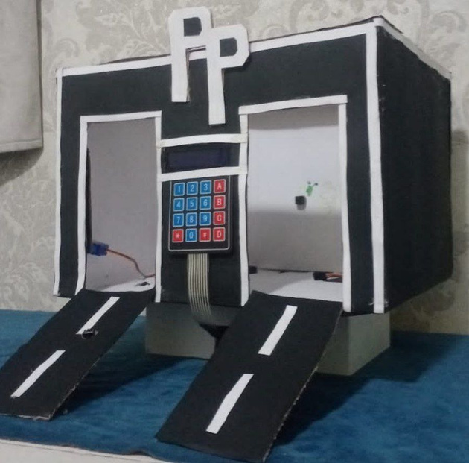
logic
Our system integrates sensors, servo motors, and a mobile app through MQTT for real-time communication.
it works by detecting vehicles at the entrance or exit using sensors. Once a car is detected, an alert is sent to the Flutter application through real-time feature in supabase . The user can then open or close the servo motors from the app, while the keypad provides an additional manual control option. Temperature and gas readings are continuously monitored and displayed on the app , with Supabase storing all sensor and gate status data for reliability and manages backend data storage and user operations.
page 03

Slide 4
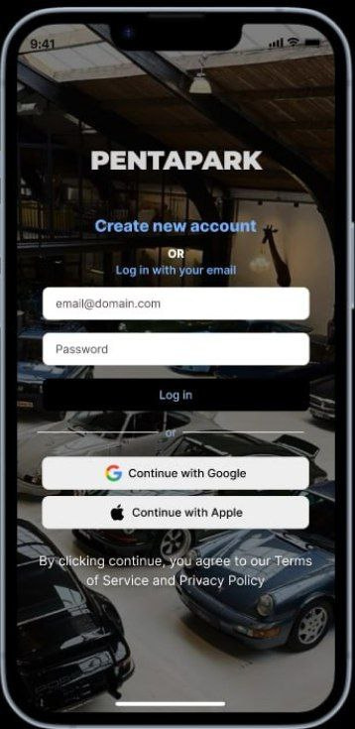
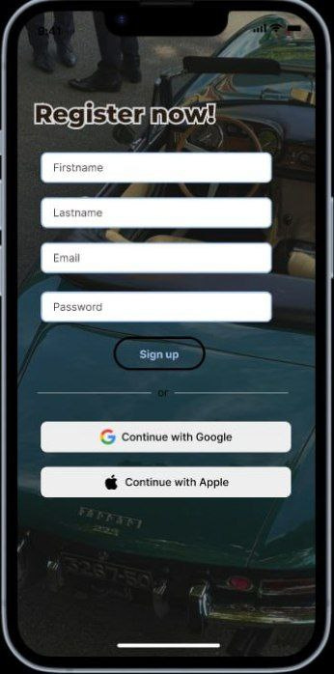
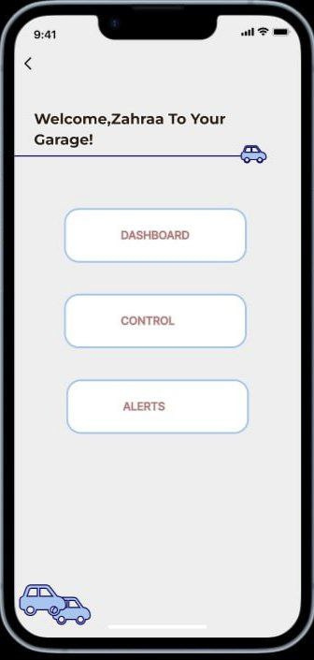
DESIGN
page 04

Slide 5
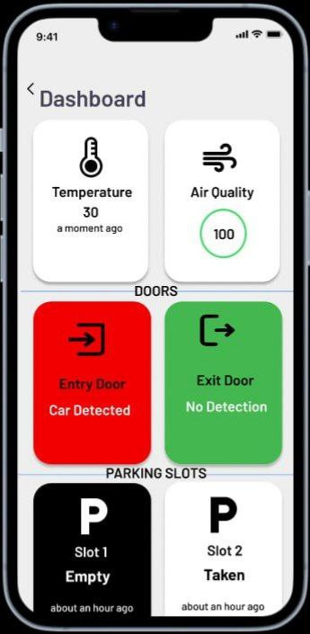
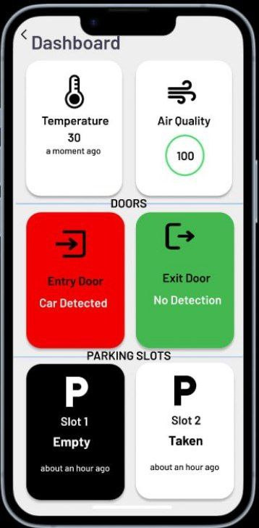
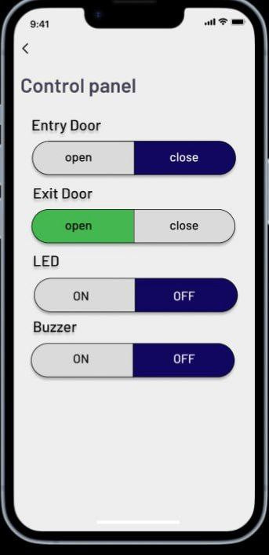
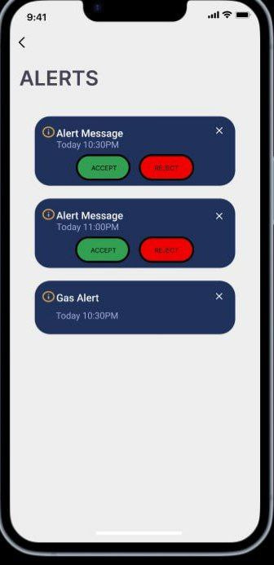
page 05

Slide 6
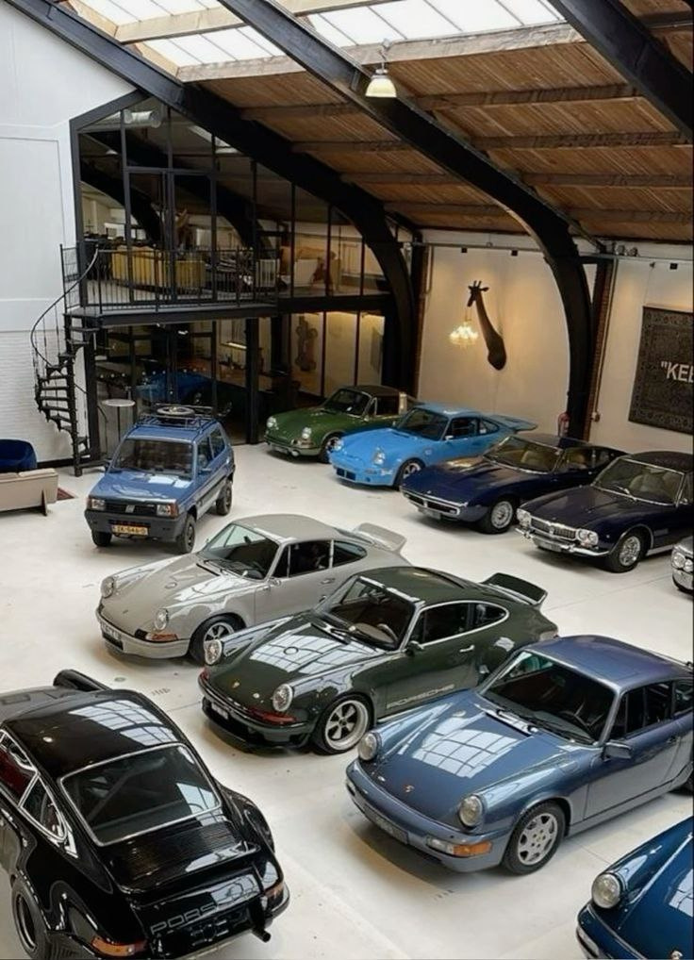
inspired by the Greek word “Penta” (meaning five), linking the theme to Greek culture.
For the background, we used Greek cars to connect the app’s identity with its name.
The color palette was chosen from this theme:
For alerts and door status (Open/Close), we used Green and Red to improve user experience and make actions clear.
BLUE, WHITE, BEIGE (#EEEEEE),BLACK, AND NAVY.
page 06

Slide 7

The app design is divided into 6 main screens:
Main Page (Login).
Register Page (Create Account).
Welcome Page – includes main features (Dashboard, Control, Alerts).
Dashboard – displays sensors, doors, and parking slots.
Control Panel – manual control of garage .
Alerts Page – shows notifications and warnings.
Dividing the app into 6 screens ensures organized navigation and a smooth user journey.
FIGMA LINK: https://www.figma.com/design/Pby2EZ503pFrUEVLuXCTsf/first1?node-id=3-61&t=sxarqec0E6ycOw55-1
page 07

Slide 8


TECH_STACK AND SENSORS
1.
2.
3.
HARDWARE
SOFTWARE
SENSORS
ESP32,IR Sensors, Gas_sensor, Heat_sensor,Servo Motor,Buzzer + LED, LCD, Keybad
Arduino IDE (C)
Libraries (WiFi, Servo, etc.)
HiveMQ
FlutterApp
IR
GAS (MQ-2)
HAET SENSOR
page 08

Slide 9
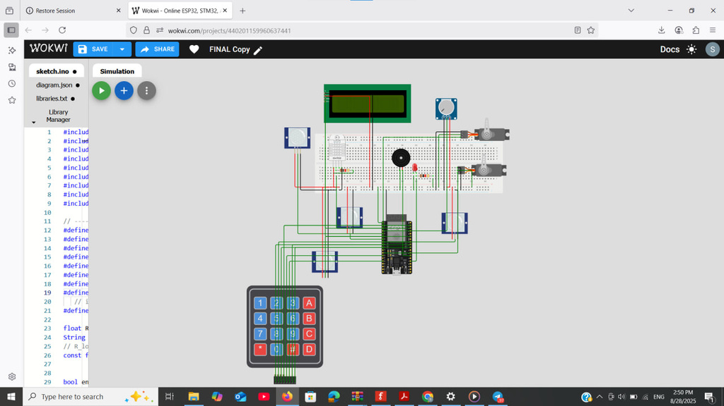
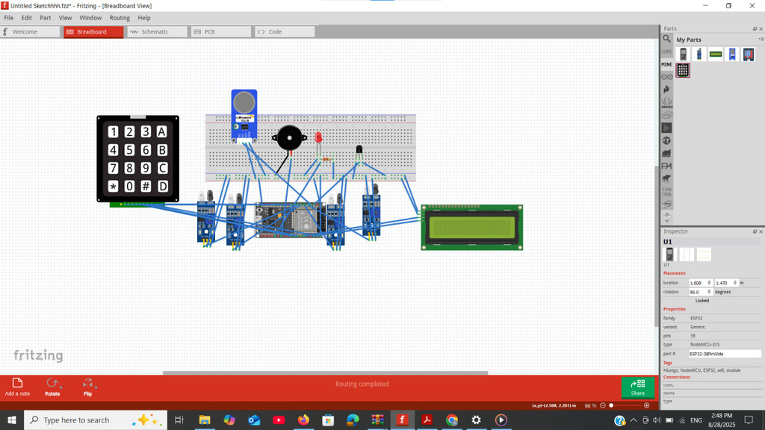
HARDWARE(WOKWI CIRCUIT AND SCHEMATIC)
Wokwi link: https://wokwi.com/projects/440201159960637441
page 09

Slide 10
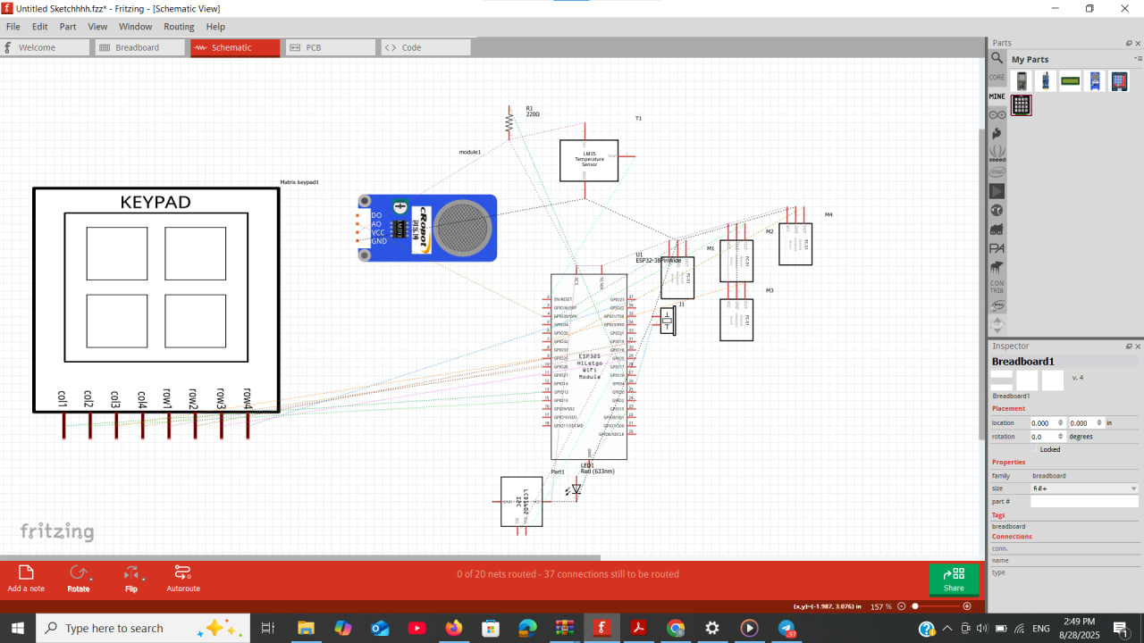
SCHEMA
page 10

Slide 11

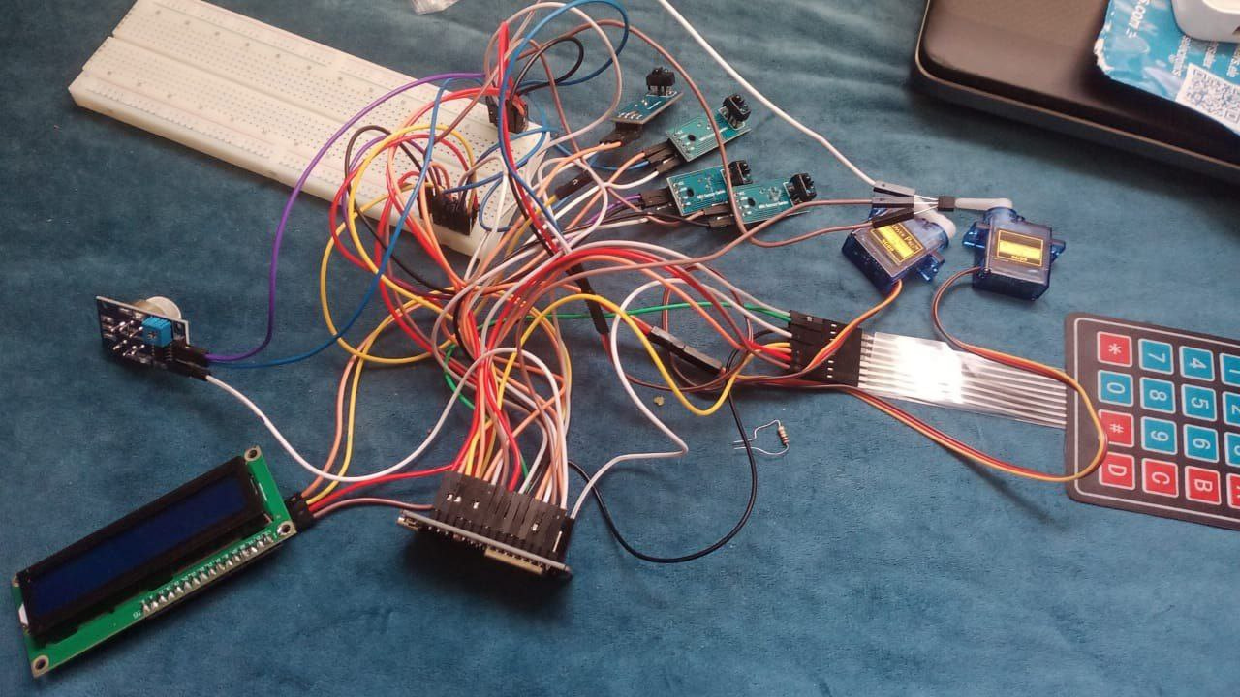
CONNECTIONS
Initial hardware setup :
ESP32 connected with input devices (sensors, keypad) and output devices (LCD, servo motors, buzzer) – complete wiring before integration.”
page 11

Slide 12
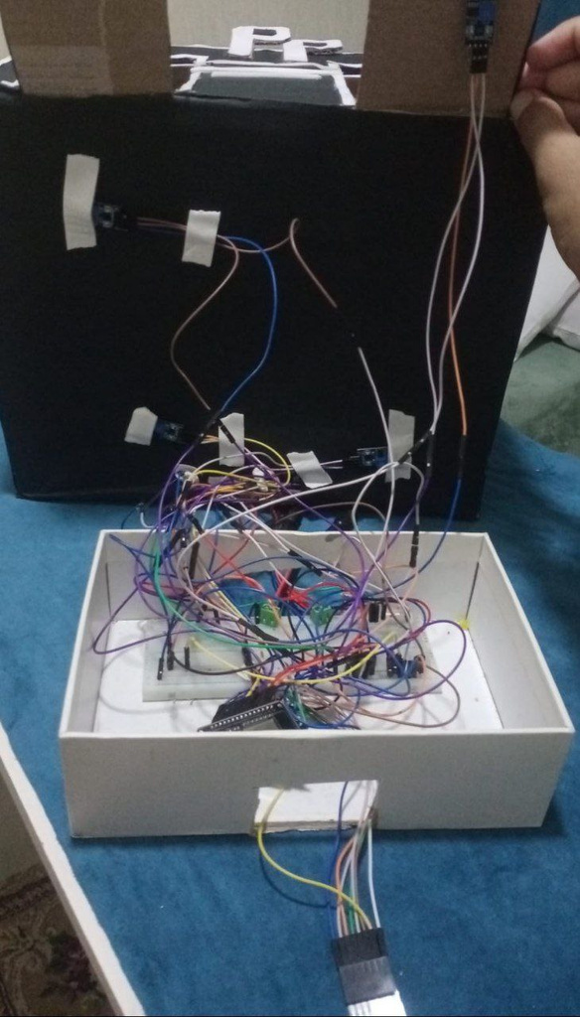
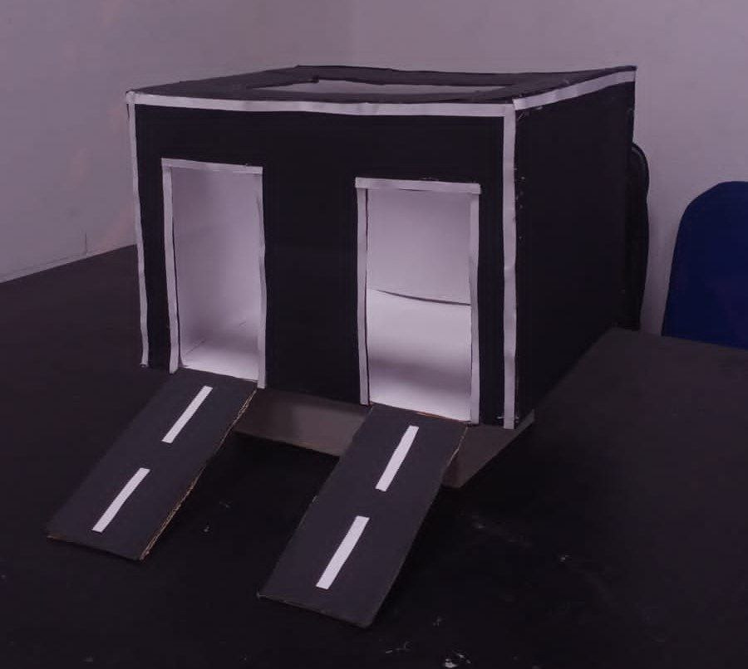
The makket integrates all components with the ESP32: sensors at entrance/exit, servo motors for gates, LCD, and keypad for manual control.
page 12

Slide 13
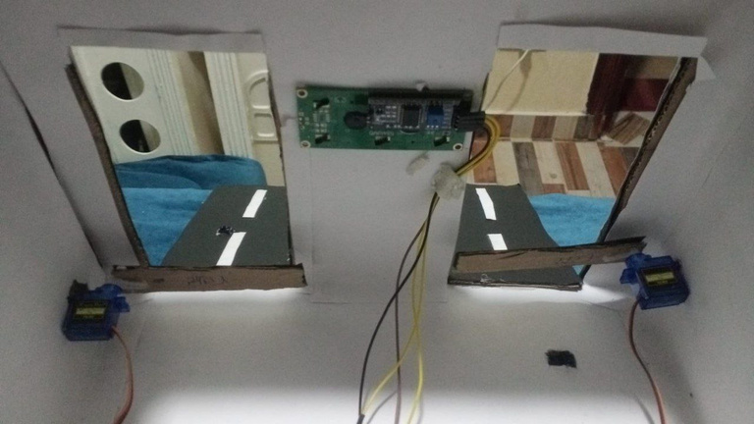
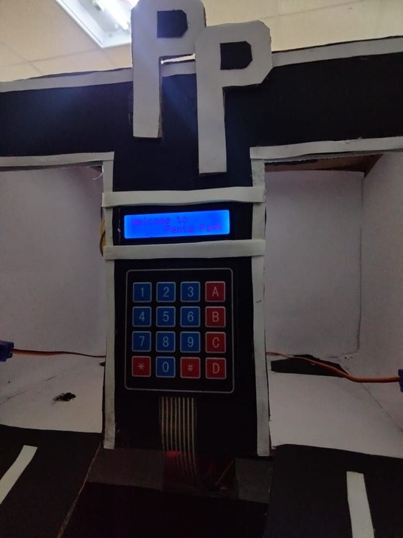
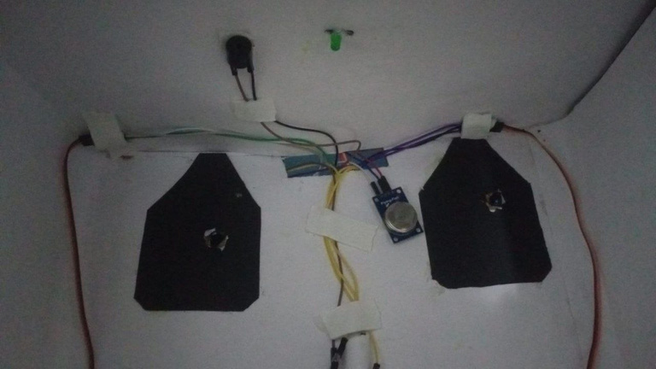
Internal view of the garage model showing :
hardware components are placed in their functional positions: sensors at the gates, servo motors controlling entry/exit, LCD displaying “WELCOME TO PENTA PARK”, and keypad for manual operations.”
page 13

Slide 14
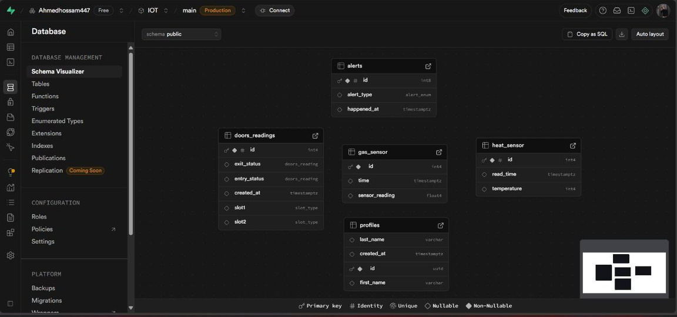
ABOUT SUPABASE
In our project, Supabase is used as the main database. We designed tables to store sensor readings and system states.
To ensure data integrity and consistency, we applied ENUMs for fixed values, Primary Keys for unique identification, and Indexes to optimize query speed.”
page 14

Slide 15
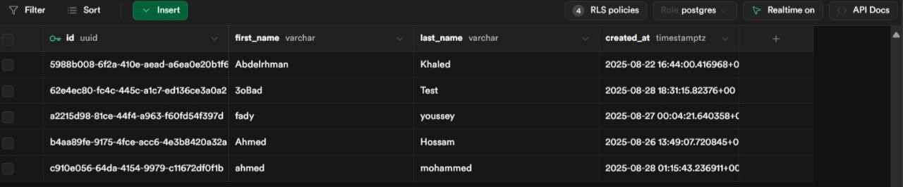
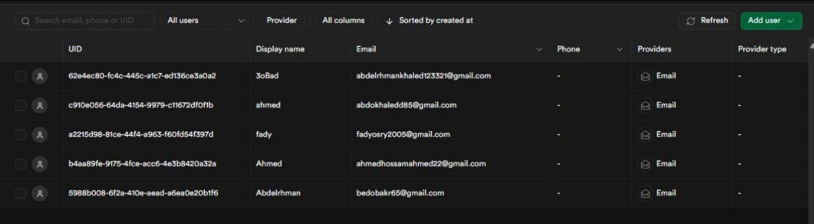
Authentication is managed directly by Supabase. Each user’s basic login info is stored securely, and through foreign keys we connect it to another table that contains extra details like full name. This ensures security, clean structure, and easy access.”
page 15

Slide 16
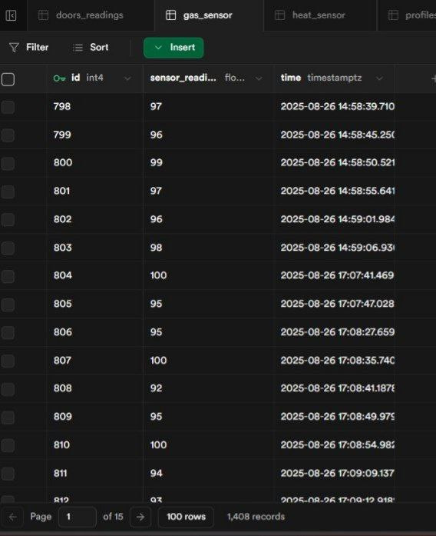
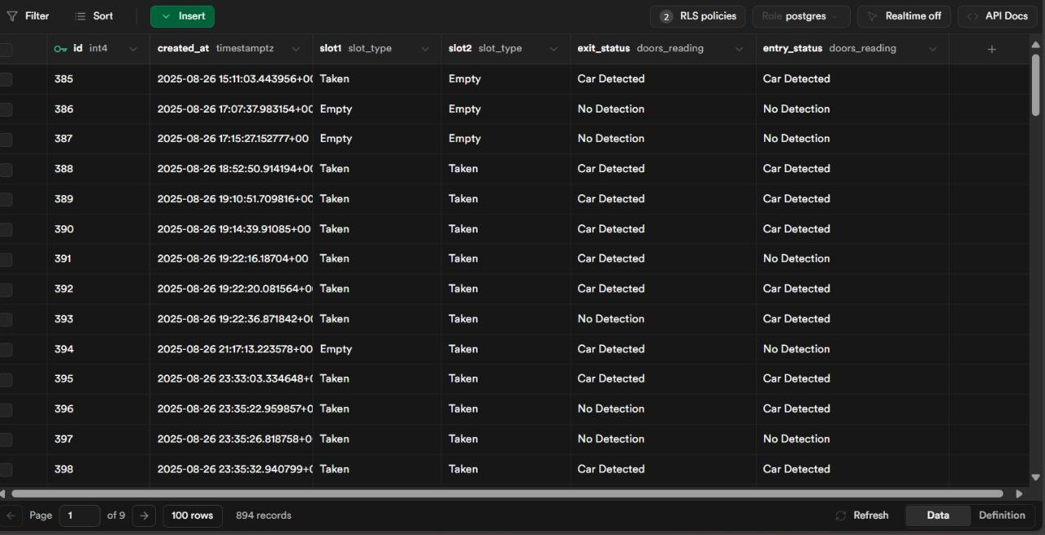
This view from Supabase shows how sensor readings (temperature, gas, parking status, etc.) are stored directly in the database tables for further monitoring and analysis.
page 16

Slide 17
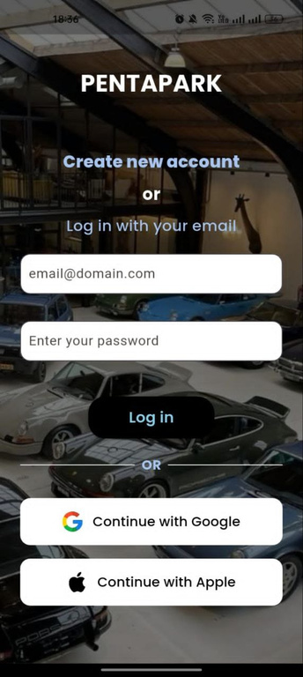
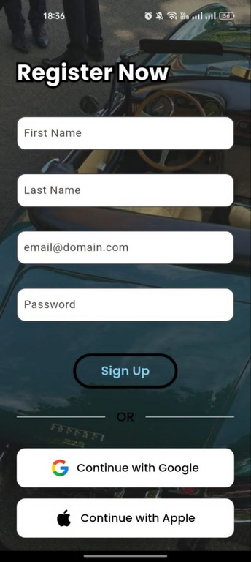
INTEGRATION WITH FLUTTER APP
The Flutter application is the user interface of our Smart Garage system.
It provides secure authentication with supabase ( login and registration).
page 17

Slide 18
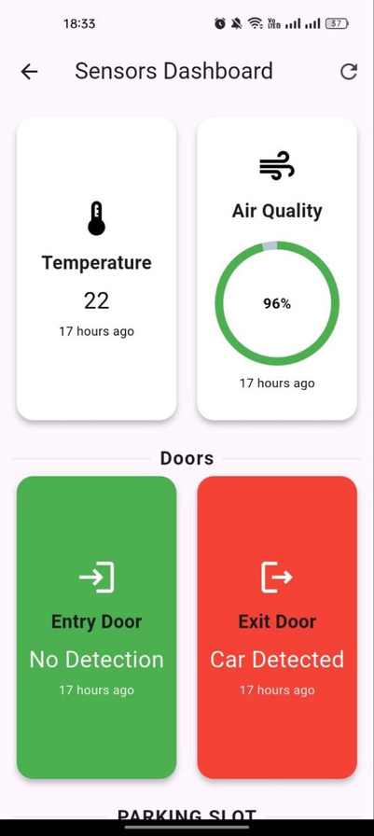
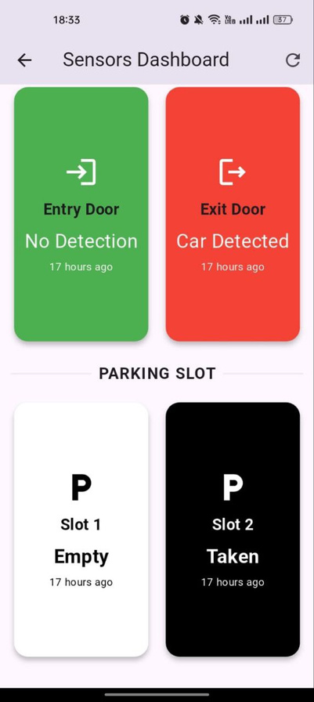
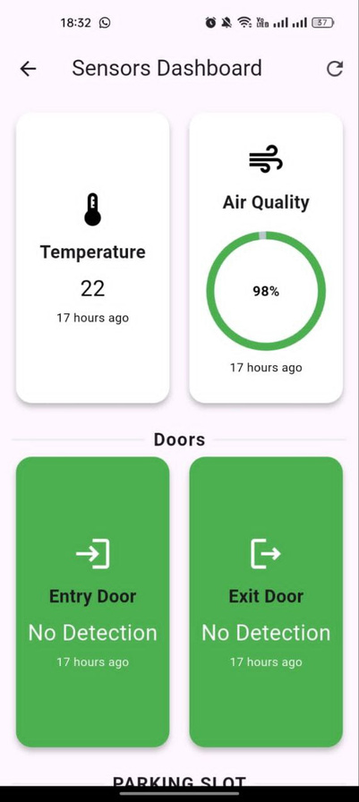
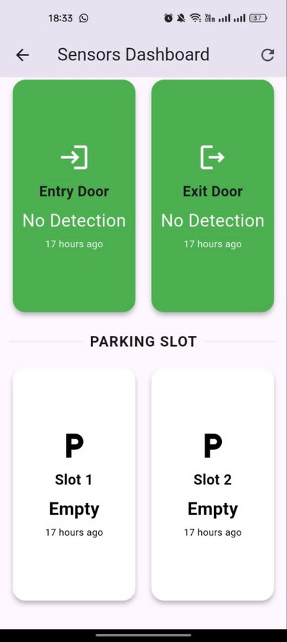
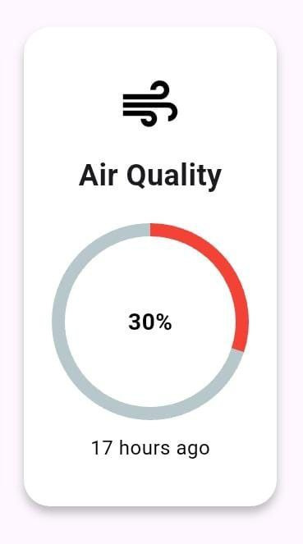
The dashboard continuously updates data, stores it through Hive, and ensures safety by monitoring temperature and gas sensors in real time.
page 18

Slide 19
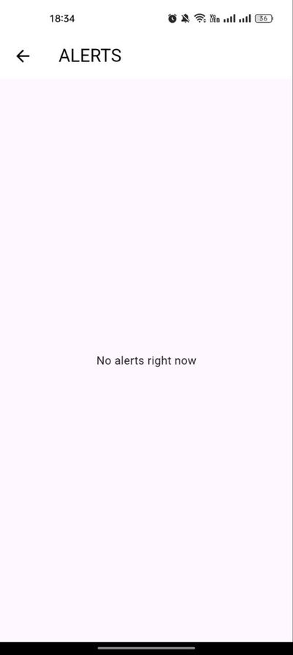
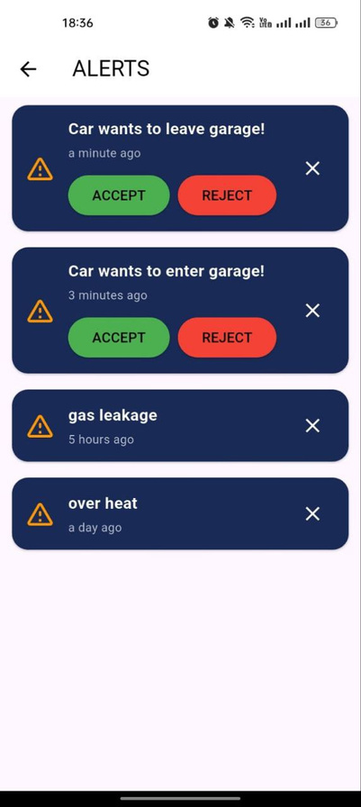
The alert system is a core feature of our Smart Garage. It continuously monitors sensor readings (e.g., gas, temperature, door status). If any abnormal or risky condition is detected, an alert is generated instantly.
This real-time monitoring enhances security, ensures safety, and improves user experience
page 19

Slide 20
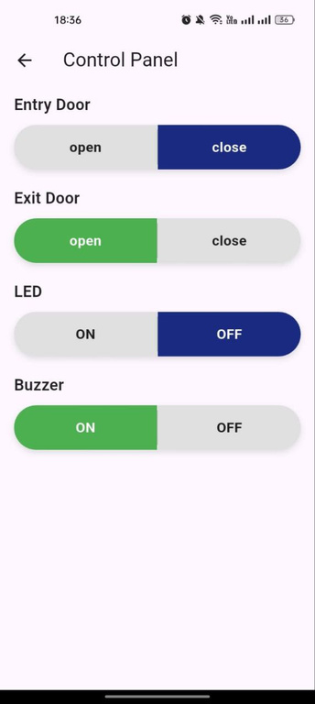
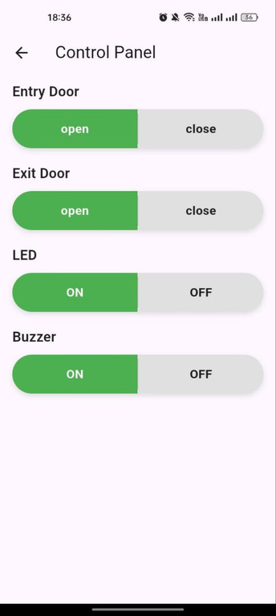
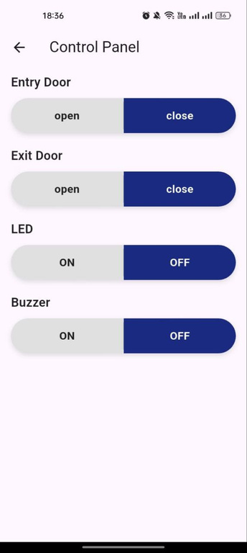
The control panel in the. application allows users to directly manage the garage hardware. Through the app, users can open and close the garage doors by controlling the servo motors, activate or deactivate the buzzer for alerts, and switch the LED on or off to indicate different statuses. This provides full remote control, flexibility, and a seamless smart experience.
page 20

Slide 21
Github link : https://github.com/abdobakr5/PentaPark
video documentaion link : https://drive.google.com/file/d/12RSq1G1QWNPVbcXEN0yi8vlXMtXNUxf9/view?usp=sharing
IMPORTANT LINKS
figma link : https://www.figma.com/design/Pby2EZ503pFrUEVLuXCTsf/PentaPark?node-id=3-61&t=cECP4nqdvf9hb3V3-1
Wokwi link : https://wokwi.com/projects/440201159960637441
page 21

Slide 22
THANK YOU!
Innovation is not about ideas, it’s about making them real
page 22

